Slide 1

INSTITUTE UIE
DEPARTMENT ACADEMIC UNIT-1
Bachelor of Engineering (Computer Science & Engineering)
Subject Name Semi Conductor Physics
Subject Code 23SPH-143
Prepared By
Dr.Anuj Kumar Goel
Lecture-2.2.3
Visible Light Emitting Diodes and Displays.
DISCOVER . LEARN . EMPOWER

Slide 2
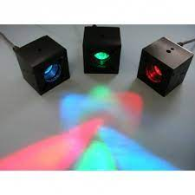
Lecture Objectives
S. No. | Objectives
1 | To make student aware about the basic concept of Light emitting diodes.
2 | To aware about working principle of LED.
3 | To provide knowledge about types and construction of LED.
4 | To make familiar with the features of LEDs.
5 | To give brief knowledge about applications of LEDs.
https://library.automationdirect.com/basic-electrical-theory/

Slide 3
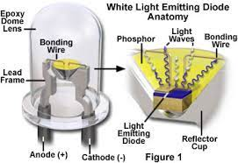
Course Objectives
S. No. | Objectives
1 | To understand the basic materials and properties of semiconductors.
2 | Understand the basic of semiconductor and components like diode, transistor, FET, MOSFET and Energy Sources.
3 | To give knowledge about semiconductor physics and discus working and applications of basic devices, including p-n junctions, BJTs and FETs.
https://library.automationdirect.com/basic-electrical-theory/

Slide 4
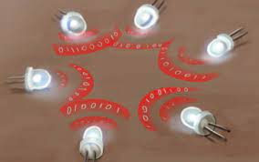
Course Outcomes
CO Number | Title | Level
CO1 | To apply the knowledge of basic semiconductor material physics and understand fabrication processes. | Remember
CO2 | To understand the characteristics of different electronic devices such as diodes, transistors. | Understand
CO3 | To derive the relationships between the parameters in diode, FET, configurations of Transistor and MOSFETs. | Analyze
CO4 | To describe the working and design considerations for the various photonic devices like photo detectors, solar-cells and LEDs. | Evaluate
CO5 | To provide problem solving experience and learning of concepts through it in semiconductor physics. | Create
https://library.automationdirect.com/basic-electrical-theory/

Slide 5
Content
Introduction to visible LEDs.
What is an LED?
How LED works.
Energy band diagram of LED.
Construction of LED.
Electrical characteristics of LED.
What determines the color of LED.
How much light do LEDs produce.
What makes LEDs suitable for illumination applications?
Features and Benefits of LED.
Applications of LEDs.

Slide 6
Introduction to LEDs
LEDs are promising light source whose efficiency was 10 times greater than the incandescent lighting.
Long operating life and reliability has made LEDs as a potential choice for next generation lighting systems, including automotive, emergency, backlight, indoor and outdoor.
LED lighting can also be referred to as solid-state lighting (SSL) because an LED is solid-state technology.[Solid State Semiconductor Device]
LEDs were first developed in 1960s and its characteristics decides this light source is suitable for indication not illumination.

Slide 7


Introduction to LEDs
Indication:
Indication – refers – use of light source – viewed directly – self luminous object.
Ex: Signs, signals, indicator lights in electronic equipments.
Illumination:
Illumination – refers – use of light source – view other object by the light reflected from those object.
Ex: Lightings found in rooms and Task lightings in desk.
LED - Indicator
LED - Illuminator

Slide 8
Introduction to LEDs
LEDs are quite effective and efficient for colored light applications.
Unlike conventional signs and signals which use a nominally white light source and a colored glass or plastic filter or lens to create the sign or signal, colored LEDs require no filtering.
The light absorbed by the filters in the conventional products is essentially wasted, and because of this waste, the luminous efficacy of LED signs and signals is often higher than those using conventional white light sources.

Slide 9
Introduction to LEDs
The development of white light LEDs in the mid-1990s, have made LED illumination systems feasible for some applications, and a number of products are now available on the market.
At present, typical indicator LEDs have light outputs on the order of one to several lumens, whereas LEDs for illumination produce on the order of tens to hundreds of lumens.
[lumens - (denoted by lm) are a measure of the total amount of visible light (to the human eye) from a lamp or light source. The higher the lumen rating the “brighter” the lamp will appear.]
As the LED technology revolutionize the lighting industry so it’s important to understand how an LED light source works.

Slide 10
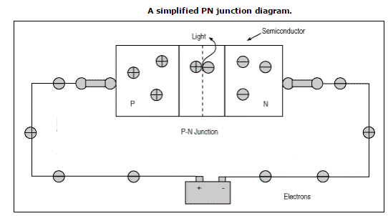
What is an LED?
LEDs are semiconductor diodes, electronic devices that permit current to flow in only one direction.
The diode is formed by bringing two slightly different materials together to form a PN junction .
In a PN junction, the P side contains excess positive charge ("holes," indicating the absence of electrons) while the N side contains excess negative charge (electrons).

Slide 11
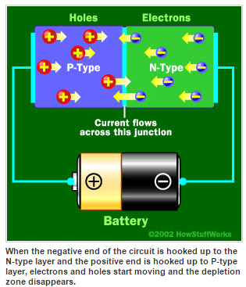
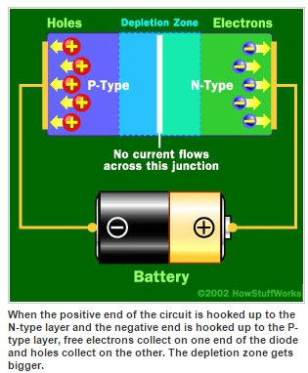
How LED Works?

Slide 12
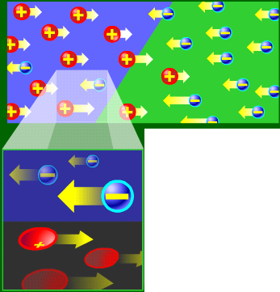
How LED Works?
When current flows across a diode.
Negative electrons move one way and positive holes move the other way

Slide 13
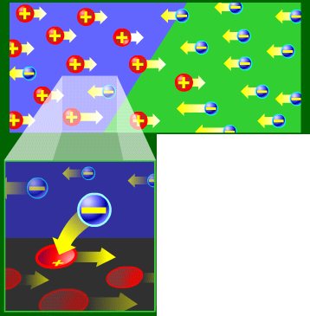
How LED Works?
The holes exist at a lower energy level than the free electrons.
Therefore when a free electrons falls it losses energy

Slide 14
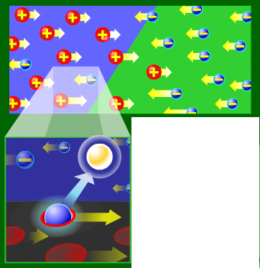
How LED Works?
This energy is emitted in a form of a photon, which causes light.
The color of the light is determined by the fall of the electron and hence energy level of the photon.

Slide 15
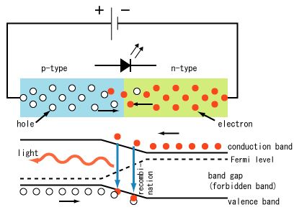
Energy band diagram of LED
Electron – Hole recombination

Slide 16
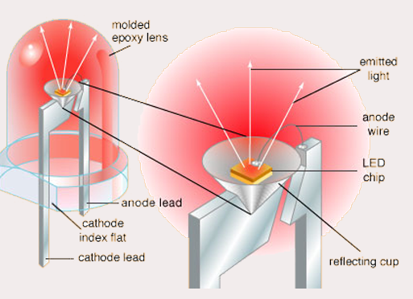
LED Construction

Slide 17
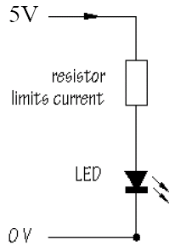
How to Connect a LED?
Requires 1.5~2.5V and 10 mA
To prevent overloading, use resistor 470 Ω

Slide 18
Electrical characteristics of LEDs
Individual LEDs are low voltage devices.
Single indicator LEDs require 2 to 4 volts of direct current, with current in the range from 1 to 50 milliamperes.
An illumination-grade LED containing a single semiconducting element requires the same voltage, but operating currents are much higher, typically several hundred milliamperes.
A device containing multiple elements connected in series will require higher voltage corresponding to the larger number of individual elements in the device.
Reverse polarity destroys an LED.
Manufacturers provide specifications about the maximum reverse voltages acceptable for LED devices; 5 volts is a typical maximum rating.

Slide 19
What Determines the color of the LED
The material used in the semiconducting element of an LED determines its color.
The two main types of LEDs presently used for lighting systems are aluminum gallium indium phosphide (AlGaInP, sometimes rearranged as AlInGaP) alloys for red, orange and yellow LEDs.
Indium gallium nitride (InGaN) alloys for green, blue and white LEDs. Slight changes in the composition of these alloys changes the color of the emitted light.

Slide 20
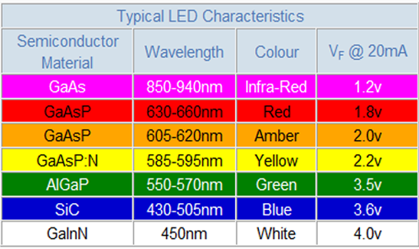
How much light do LEDs produce?

Slide 21
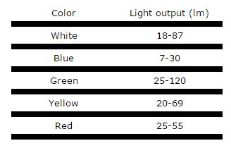
How much light do LEDs produce?

Slide 22
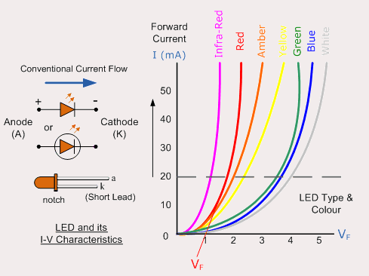
V-I Characteristics of LED

Slide 23
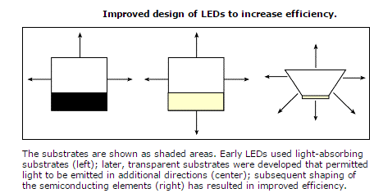
What now makes LEDs suitable for illumination applications?
LED construction has also changed to make them more efficient.
The crystals forming early LED junctions were grown on light-absorbing substrate materials.
Using transparent substrates and optimizing the shape of the semiconducting element have increased the amount of light able to leave the device

Slide 24
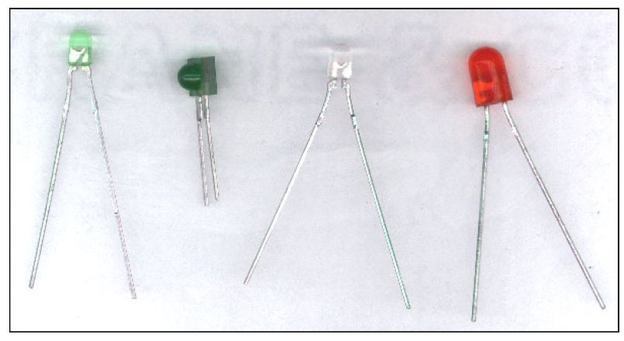
Kinds of LEDs

Slide 25
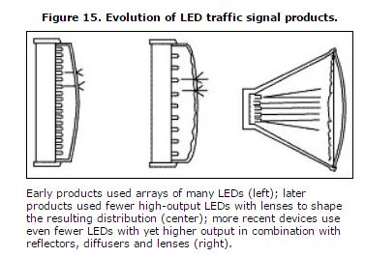
How are LEDs packaged into systems for lighting applications?

Slide 26
Features & Benefits of LED
LED’s are extremely efficient low energy light sources.
In 2005 white LED’s had reached outputs of over 30 lumens/Watt and coloured versions 50 lumens/Watt.
The light gains continue to grow, doubling about every two years.
Long operational life of up to 50,000 hours.
Compact light source, no other lamp possesses such small dimensions for a comparative light output.

Slide 27
Features & Benefits of LED
LED’s do not emit ultraviolet (UV) or infrared (IR) radiation. They do not radiate heat in the direction of the illuminated object, they can therefore be used to illuminate materials that fade easily, food, works of art etc.
LED’s are durable against impact and vibration.
LED’s can be dimmed.
Coloured light can be produced effectively - over 16 million colours.

Slide 28
Common Application
- Display lighting - compact displays are possible with low operating temperatures - Display case, museum and shop lighting - illumination of sensitive objects at close range with ultraviolet (UV) and infrared(IR) free light - Underwater lighting - low voltage supply for safety and low maintenance - Outside lighting - coloured effects to enhance outdoor spaces - Sign lighting - strips of LED’s can be used to light signage in many different colours - Low level lighting - LED luminaires are cool to touch and are therefore suitable for us in domestic situations where children may come into contact with them - Architectural detail lighting.
- LED’s can be used in applications which traditionally used neon or cold cathode.

Slide 29
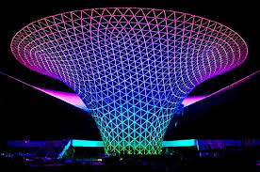
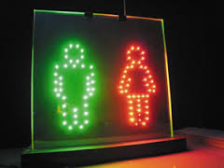
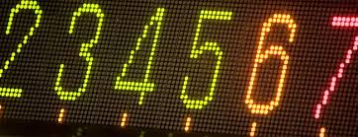
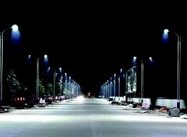

Slide 30
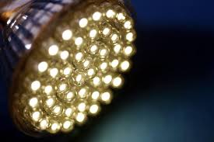
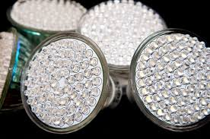



Slide 31
Summary
Introduction to Visible LEDs.
Various types of LEDs.
Electrical and V-I Characteristics of visible LED.
How to connect a LED.
Features and Applications of Visible LEDs and Displays.

Slide 32
Frequently Asked Questions
What is the working principle of LED?
Give the example of different colored LEDs.
How to make 7 segment display?
Define construction of LED.
What are the applications of LEDs?

Slide 33

LEARNING OUTCOMES
To make students understand
Concepts of visible LED and relate them to practical engineering systems.
Importance of light spectrum.
Understanding of electrical characteristics of LEDs.

Slide 34
Course Outcome to Program Outcome Relationship
 |  | (21ELH-101) BEEE
PO→
CO↓ | PO1 | PO2 | PO3 | PO4 | PO5 | PO6 | PO7 | PO8 | PO9 | PO10 | PO11 | PO12 | PSO1 | PSO2 | PSO3
CO1 | 3 | 2 | 0 | 0 | 1 | 0 | 0 | 0 | 0 | 0 | 0 | 0 | 2 | 0 | 0
CO2 | 3 | 2 | 0 | 0 | 1 | 0 | 0 | 0 | 0 | 0 | 0 | 0 | 2 | 0 | 0
CO3 | 3 | 2 | 0 | 0 | 1 | 0 | 0 | 0 | 0 | 0 | 0 | 0 | 2 | 0 | 0
CO4 | 3 | 2 | 0 | 0 | 1 | 0 | 0 | 0 | 0 | 0 | 0 | 0 | 2 | 0 | 0
CO5 | 3 | 2 | 0 | 0 | 1 | 0 | 0 | 0 | 0 | 0 | 0 | 0 | 2 | 0 | 0

Slide 35
Assessment Pattern
A Assignment (each assignment) | B Time Bound Surprise Test (each test) | C Quiz (each quiz) | D Mid Semester Test(one per test) | E Homework | F Discussion Forums | G Attendance and engagement Score on BB
10 | 12 | 4 | 20 | NA | NA | 2

Slide 36
References
Text Books
Semi-Conductor Physics & devices- Basic Principles, Donald.A. Maemen,4th Edition, MacGraw Hill,2021.
Physics of Semiconductor Devices By Pearson, M.Shur, 4th Edition , Pearson.
Principles Of Physics, Robert Resnick Jearl Walker, David Holliday 10th Edition 2015.
Battery Reference book, Thomas Crompton, Newnes, 3rd edition,2000.
Reference Books
Semiconductor Devices, S.Szee,Ming-Kwel Lee,3rd Edition,Wiley,2021.
Semiconductor Devices, Physics and Tech.S.Szee Ming-Kwel Lee,3rd Edition,Wiley, 2015.
Principles of Electronics, VK Mehta, Rohit Mehta, 12th Edition, S. Chand Publishing, 2014.
Solid State Electronic Devices, Ben Streetman and Sanjay Banerjee, Seventh Edition, Pearson Education India, 2015.

